Slide 1
WAQF AS SOCIAL CAPITAL EMPOWERMENT FUNDS
ISTANBUL
10TH NOVEMBER 2021
WAQF EMBEDDED ECONOMY
BY BANKWAQF INTERNATIONAL

Slide 2
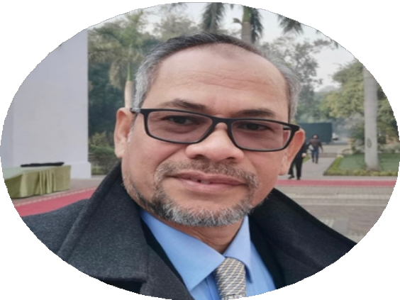
DAU QUOTE
"WAQF in economic could be defined as diverting funds and other resources from current consumption and investing them into productive and prospective assets or business which generate revenues for future consumption by individuals or society at large"
Dato' Abu Ubaidah Kemin

Slide 3
CONTENT
1
Introduction
2
Waqafa International Sdn Bhd
3
Empowered by BWi Group
4
Lists of events
5
Our Partnership & Clients
Together We Empower WaqfNomics

Slide 4
1 Introduction
WAQF IN ISLAM
WAQF ECONOMY WAQF EMBEDDED BUSINESS

Slide 5
WAQF IN ISLAM
Waqf is the act of endowing one’s property for charitable purposes to get rewards from Allah (SWT) in the hereafter (Kahf, 2003). Apart from the relationship between Muslims and our Creator, waqf also relates to the ummah’s interaction among themselves in the spirit of love, brotherhood and cooperation (Sulaiman, 2008).
According to Nadwi (2015), the institution of waqf primarily serves two objectives. First, in spiritual terms, waqf provides a vehicle for a continuous reward for the donor. Second, it leads to numerous socio-economic benefits to the community in general, particularly to the underprivileged. Which comes to the point that Muslims should be encouraged to be creative and innovative in generating revenues and providing various goods and services for Muslim societies through the implementation of
Waqf Embedded Business.

Slide 6
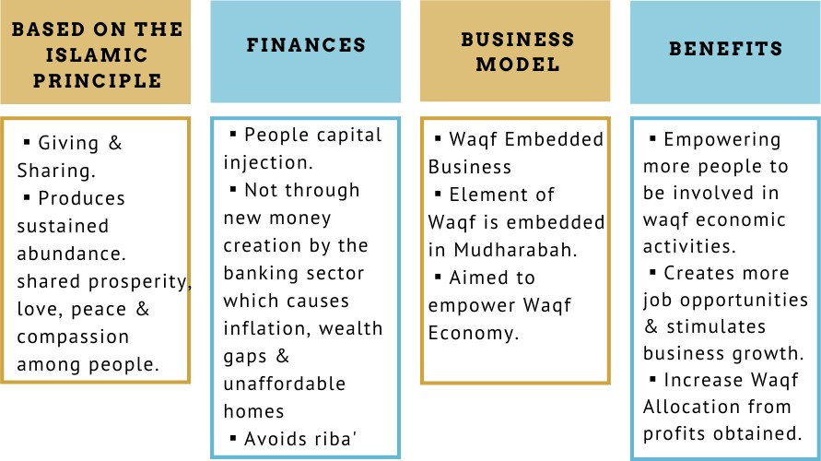
WAQF ECONOMY

Slide 8
PRINCIPLES ADHERED TO
IN MANAGING WAQF FUNDS
AMANAH
Belongs to Allah Public Interest Trustee
MAQASID
SYARIAH
Riba' free Risk sharing principles
TRANSPARENCY
Real time information
ACCOUNTABILITY
Professional Report
PROFESSIONAL
SOP driven Audited corporate governance
DIGITALIZATION
IT & Mobile Apps driven

Slide 9
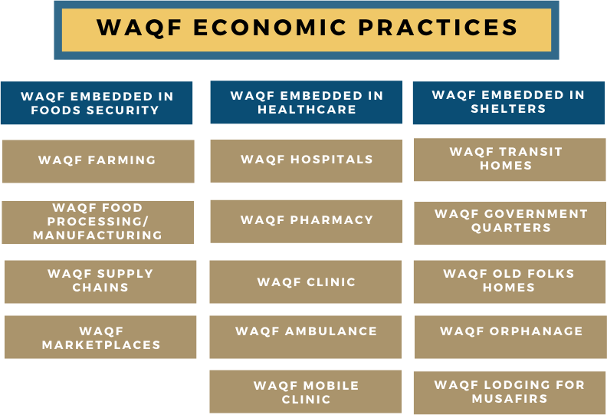
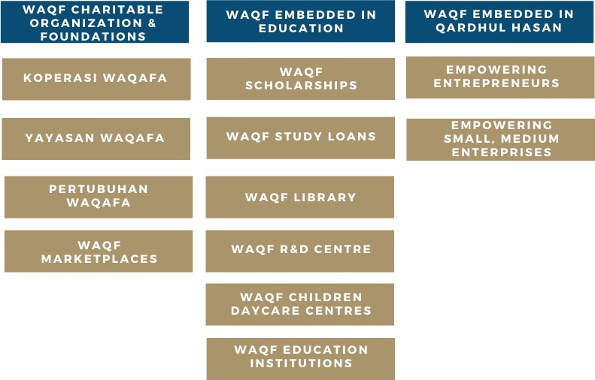

Slide 10
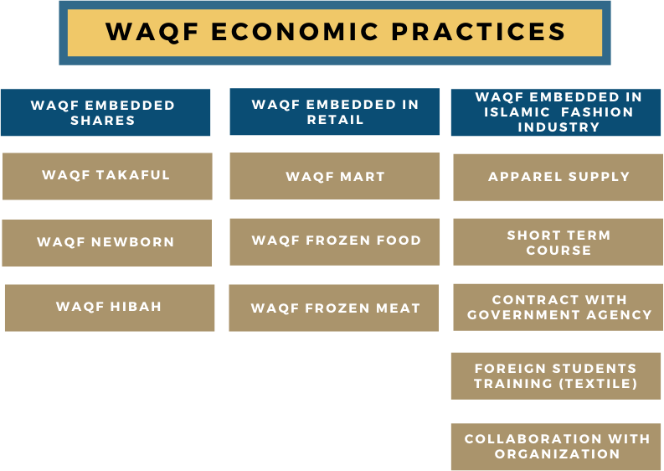
WAQF EMBEDDED BUSINESS CERTIFIED BY

Slide 11
WAQAFA INTERNATIONAL
2
ABOUT US
VISION & MISSION
BOARD OF DIRECTORS
ORGANIZATION STRUCTURE
CORE BUSINESS
DIVISIONS OF WAQAFA COMPANY INFORMATION

Slide 12
ABOUT US
WAQAFA INTERNATIONAL
SDN BHD (WAQAFA) was
established on the 18th June 2020, under the Malaysian Companies Act 2016.
It affiliates itself as a subsidiary of BankWaqf International (BWI). BankWaqf International is a trust fund established to provide business opportunities and financial services to the people in the name of Allah.
WAQAFA is part of a consortium of business entities that is dedicated to contribute 10% of their net profits for Waqf to BWi and pooled together with contributions from other business subsidiaries to be used for achieving the much desired Global Waqf Economy.
Waqf is a powerful sure way of realizing pristine Islamic Economic System. It is characterized by economic abundance, with shared prosperity, peace and tranquility for Muslims and non-Muslims alike.

Slide 13
VISION & MISSION
VISION
To see WAQF ECONOMY established through out the world.
MISSION
To continuously increase PUBLIC AWARENESS and to continuously empower businesses and individuals through its activities of RESEARCH, EDUCATE, TRAIN, PROPAGATE, CONSULT, COLLABORATE AND PRACTICE OF WAQF ECONOMY.

Slide 14
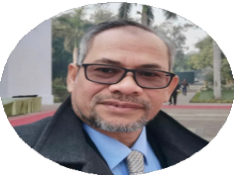
KEY PERSON
DATO' ABU UBAIDAH KEMIN
Founder and President of BankWaqf International
Dato’ Abu Ubaidah Kemin is the founder and President of BankWaqf International in 2017. Dato’ believes a holistic Waqf system is the authentic Muslim economical and financial systems. Dato’ holds the value “Grow, Earn, and Charity”. He is also the Founder of WaqfCoin Digital Platform as a medium of accelerating Waqf Funds with investments features and Co-Founder of iWAQF and appointed as Treasurer.
Dato’ graduated from International Islamic University Pakistan in Islamabad with a Bachelor Degree inDa’wah Studies. Then, Dato’ graduated from International Islamic University Malaysia in Kuala Lumpur, Malaysia.
Dato’ Abu Ubaidah is also the Founding Chairman and the Founding President for several organizations, namely Chairman & CEO of Al-Akhyar Educations Group Sdn. Bhd., Chairman of Maahad Tahfiz al-Akhyar, Founder & Chairman of Al-Akhyar International Foundation, President and Founder of TDA Malaysia, Member of Committee (Economy Division) of Al- Quran Tahfiz Schools Association (PERMATA Al-Quran), Cooperative Board Member of Al- Quran Tahfiz Schools Association Cooperative (KOPERMATA), and Member of Board at Malaysia Bumiputra Manufacturing & Industry Services Association that based in MATRADE Exhibition and Convention Centre.
He strongly encourages Muslims all over the world to engage in business in an Islamic way and by establishing the little-known but powerful bankwaqf in various Muslim communities. Bankwaqf International holds the principle that waqf property should be nourished, so the value continuously reaches the benefits for all prolonged and widened even after we leave this world. The most efficient way to raise waqf and develop the value of waqf is through business activities and Bankwaqf International as mediator between investors and businesses.

Slide 15
CORE BUSINESS
INCREASE PUBLIC AWARENESS AND PROPAGATE WAQF ECONOMY. WAQAFA CONDUCTS HALFDAY WAQF AWARENESS PROGRAMMES, ORGANIZES SEMINARS, CONFERENCES AT LOCAL AND INTERNATIONAL LEVELS.
COACH THE YOUNGER GENERATION, PARTICULARLY NEW GRADUATES, TO BECOME WAQFPRENEURS, (ENTREPRENEURS WHO ARE COMMITTED TO THE WAQF ECONOMY CONCEPT). WAQAFA SHALL HELP IN ARRANGING STUDENT INTERNSHIPS WITH ITS AFFILIATED WAQF ECONOMY BUSINESS MEMBERS.
EDUCATE BY DESIGNING WAQF PROGRAMMES AT CERTIFICATE, UNDERGRADUATE AND POSTGRADUATE LEVELS AND DELIVER THEM FACE-TO- FACE AND ONLINE. TO LOBBY UNIVERSITIES TO ADOPT WAQAFA’S MODEL INTO THEIR CURRICULUMS. OFFER JOINT WAQF PROGRAMMES WITH THE UNIVERSITIES.
COLLABORATE WITH BWI TO CONTINUOUSLY EMPOWER BUSINESSES AND INDIVIDUALS.
COMPILES MATERIALS, JOURNAL ARTICLES, BOOKS, VIDEOS, CASE STUDIES ETC. REGARDING WAQF.
PROVIDE CONSULTANCY TO GOVERNMENTS, BUSINESSES AND ORGANIZATIONS ON WAQF AND ITS VARIOUS APPLICATIONS
COMPILES VARIOUS WAQF MODELS IN ALL ITS VARIOUS APPLICATIONS.
DOCUMENT VARIOUS WAQF FINANCING MODES.
COMPILE AND CONDUCT TRAINING MODULES.
CONDUCTS RESEARCH ON WAQF; SOURCE RESEARCH GRANTS.
CONSTANTLY RECRUIT NEW BUSINESS MEMBERS TO BE PART OF THIS WAQF ECONOMY FAMILY.
COLLATE ALL PARTIES INTO A VIABLE WAQF ECOSYSTEM.
COLLABORATE WITH LOCAL AND INTERNATIONAL ORGANIZATIONS.
PRACTICE WAQF ECONOMY ITSELF.

Slide 16
DIVISIONS OF WAQAFA (BWi)
WAQAFA FOOD
WAQAFA COUNCIL
WAQAFA LODGING
WAQAFA ADVISORY
WAQAFA EDUCATION
WAQAFA R&D
WAQAFA HEALTH
WAQAFA QARDHUL HASAN
WAQAFA INVESTMENT
WAQAFA GOLD
WAQAFA SHARES
WAQAFA RETAIL
WAQAFA INFAQ
WAQAFA SERVICES
WAQAFA FARM
WAQAFA QURBAN

Slide 17
Empowered by BWi System
3
PROFIT DISTRIBUTION
BUSINESS VENTURES

Slide 18
PROFIT DISTRIBUTION
NON-WAQF FUNDS
(PRIVATE FUNDS/INVESTORS)
INVESTMENTS THROUGH BWI SYSTEM
NET PROFIT
BUSINESS OPERATOR 30%
WAQF 10%
INVESTORS & BWI 60%

Slide 19
PROFIT DISTRIBUTIONS
WAQF FUNDS
INVESTMENTS THROUGH
BWI SYSTEM
BUSINESS OPERATOR 30%
WAQF AUTOMATED 10%
WAQF REINVESTMENTS REVENUES 60%
MAUQUF 'ALAIH (BENEFICIARIES)
WAQF RESERVE FUNDS 10%
WAQF MICROCREDIT 10%
MAUQUF 'ALAIH
PEOPLES ECONOMIC EMPOWERMENTS
30%
OPERATIONS
10%
WAQF REINVESTMENT FUNDS 40%

Slide 20
BUSINESS VENTURES
To establish Gold Based Waqf Economy throughout the world To operate Gold Backed Waqf Embedded Business
Qardhul Hasan (Waqf Fund) Backed By Gold
To establish a Mudharabah (Profit Sharing) system that empowers Waqf Economy
Encourages participation in the Annual Qurban & waqf contribution
Harvesting & logging activities which contributes to Waqf Based Economic Outcomes

Slide 21
BUSINESS VENTURES
Waqf Embedded Lodging:
To alleviate the burden of long term accomodation rates
Investment: RM25,000 (Non Waqf Fund)
A project initiated to address the shortage of Halal Beef production while providing investment opportunities
To address core food security issue by empowering local beef producers
Waqf Embedded Business: Cashew nut processing and packaging for exporting
Investment: RM1,500,000 (Non Waqf Fund)

Slide 22
BUSINESS VENTURES
Waqf Embedded Farm: Goat farm for trading and rearing
Providing an alternative market as well as job opportunites and value chain
Investment: RM170,000 (Non Waqf Fund)
Waqf Embedded Service: Copier machine rental and services
Maintaining and developing new ways in securing more renting opportunites
Investment: RM38,000 (Non Waqf Fund)
DIGITAL PRINTING
Waqf Embedded Farming: Aquaponic for vegetables and catfish
Join-venture with local collection center which handles supplying local demand
Investment: RM55,000 (Non Waqf Fund)
AQUAPONIC

Slide 23
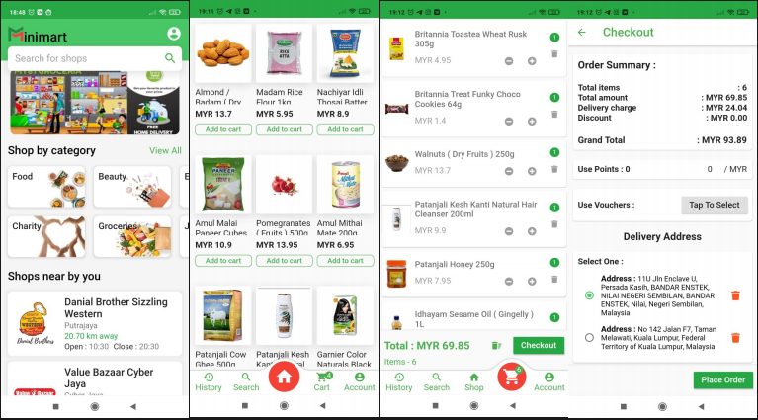
NEW PROJECT VENTURES
Waqf Embedded Apps: Minimart application
Digital Start Up Platform: Providing an online grocery shopping platform as well as food bank supplies
Investment: RM400,000 (Non Waqf Fund)

Slide 24
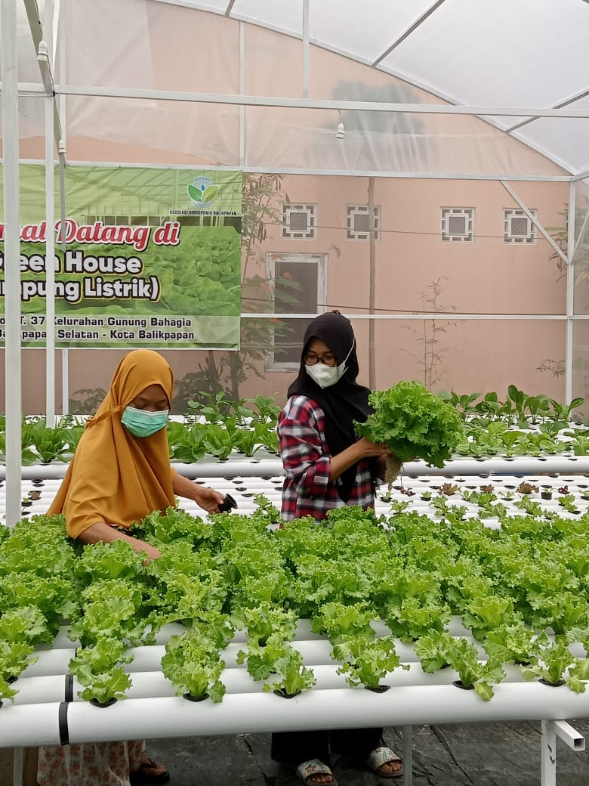
NEW PROJECT VENTURES
HYDROPONICS
Waqf Embedded Farming: Hydroponics project
Location: Balikpapan, Indonesia
Supplying fresh vegetables for local demand
Investment: RM24,000 (Non Waqf Fund)

Slide 25
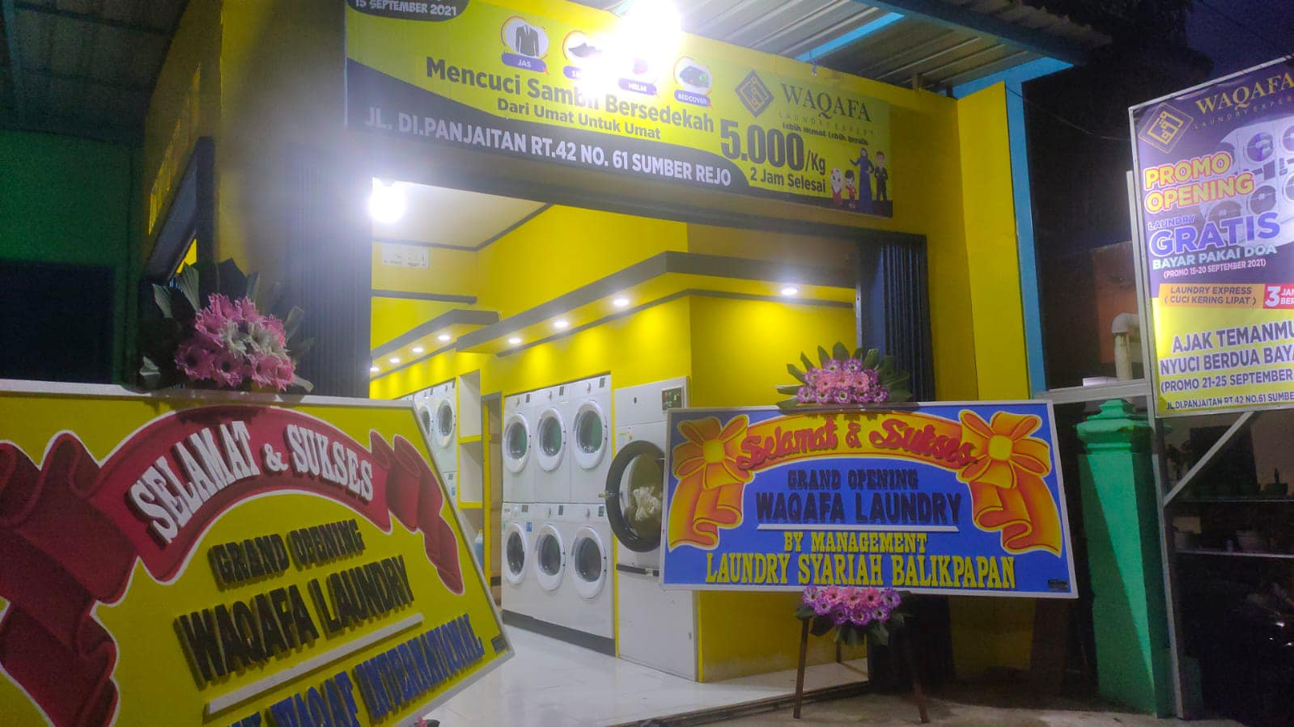
NEW PROJECT VENTURES
Waqf Embedded Services: Digital Laundry
Location: Balikpapan, Indonesia
DIY Laundry using digital platform mobile application
Investment: RM80,000 (Non Waqf Fund)

Slide 26
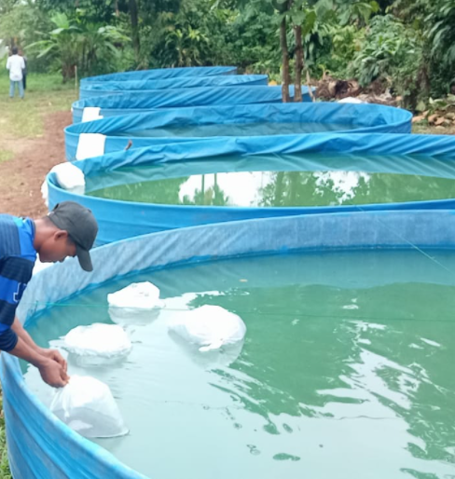
NEW PROJECT VENTURES
FISH BREEDING
Waqf Embedded Farming: Silver CatFish breeding pond
Location: Bogor, Indonesia
Supplying matured silver catfish for local market
Investment : RM20,000 (Non Waqf Fund)

Slide 27
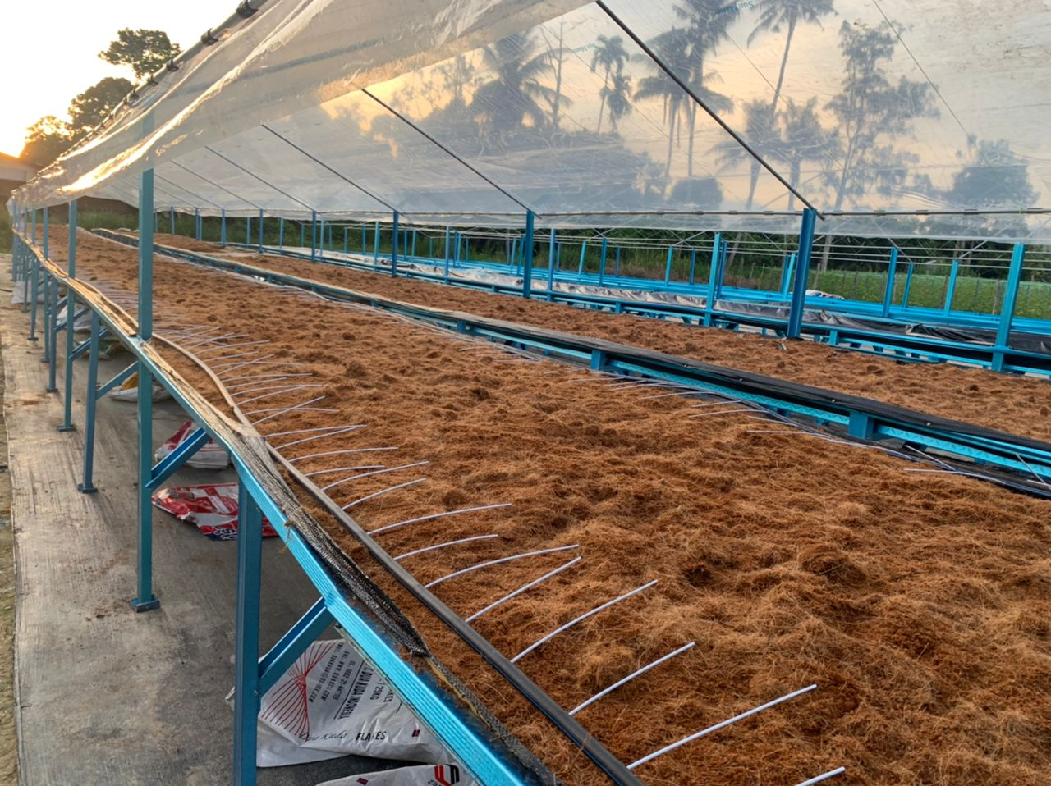
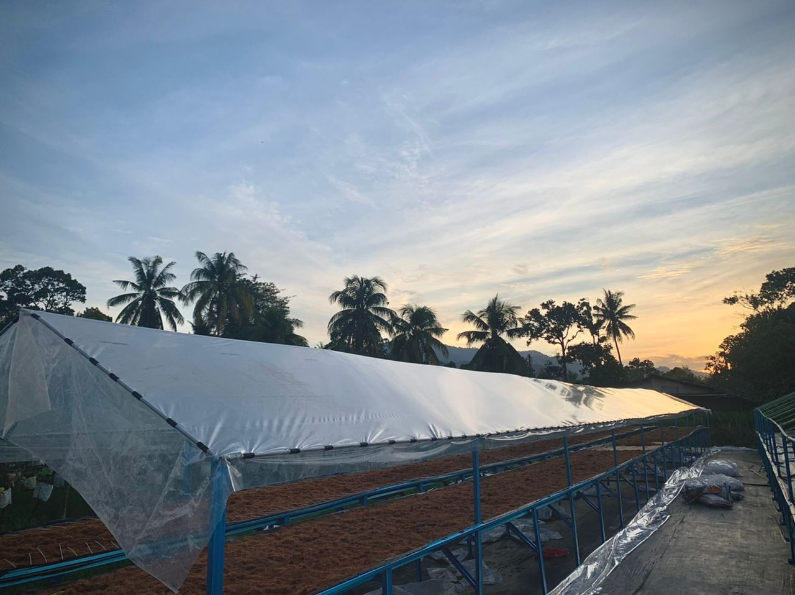
NEW PROJECT VENTURES
AQUAPONIC
Waqf Embedded Farming: Table type aquaponic fertigation for vegetables and catfish
Location: Kuala Kangsar Perak, Malaysia
Join-venture: with local collection center which handles supplying to local markets
Investment : RM55,000 (Non Waqf Fund)

Slide 30
Lists of Events
4
SEMINAR
WEBINAR CONFERENCE

Slide 31
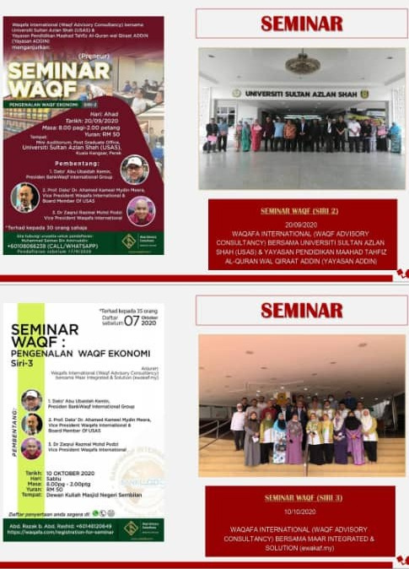
AWARENESS: SEMINAR

Slide 32
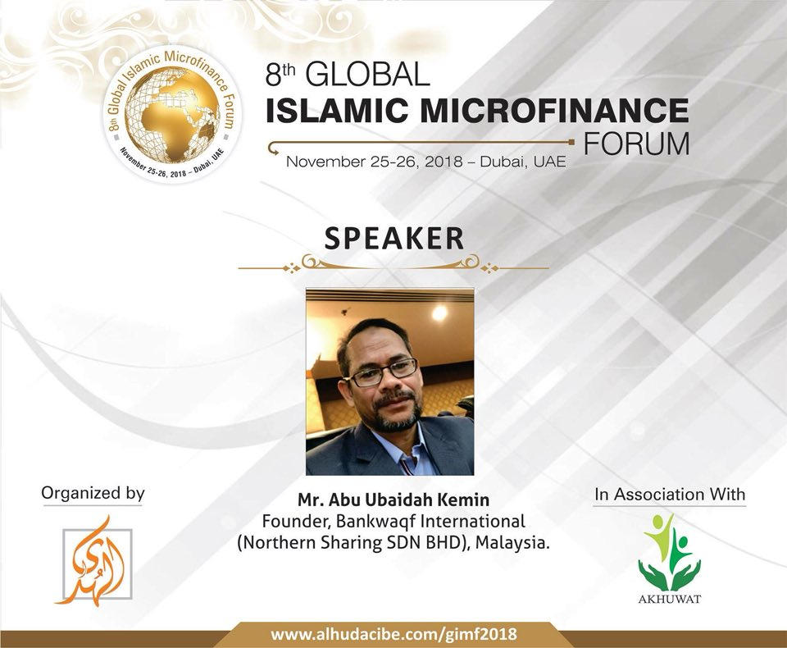
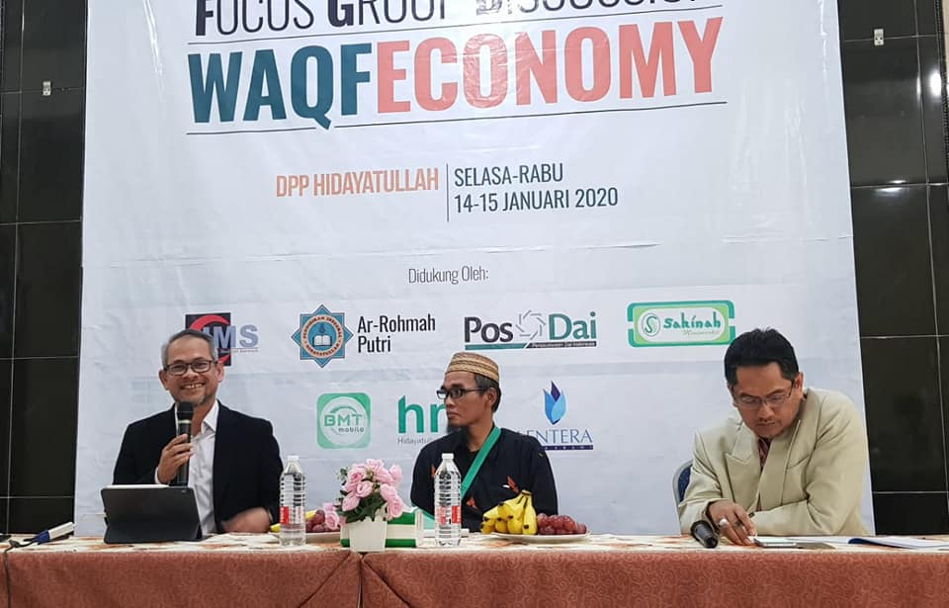
TRAINING & WORKSHOP

Slide 33
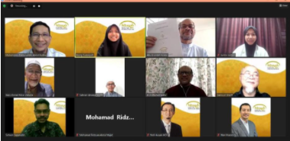
ZOOM MEETING & FB LIVE

Slide 34
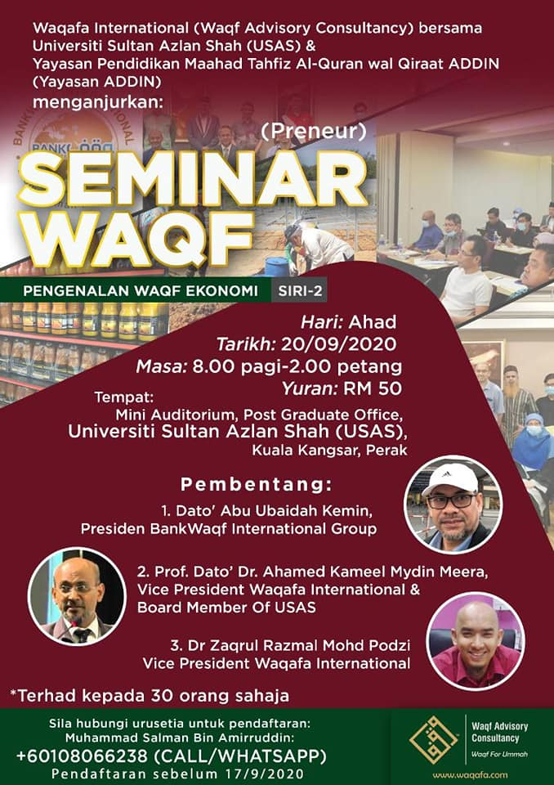
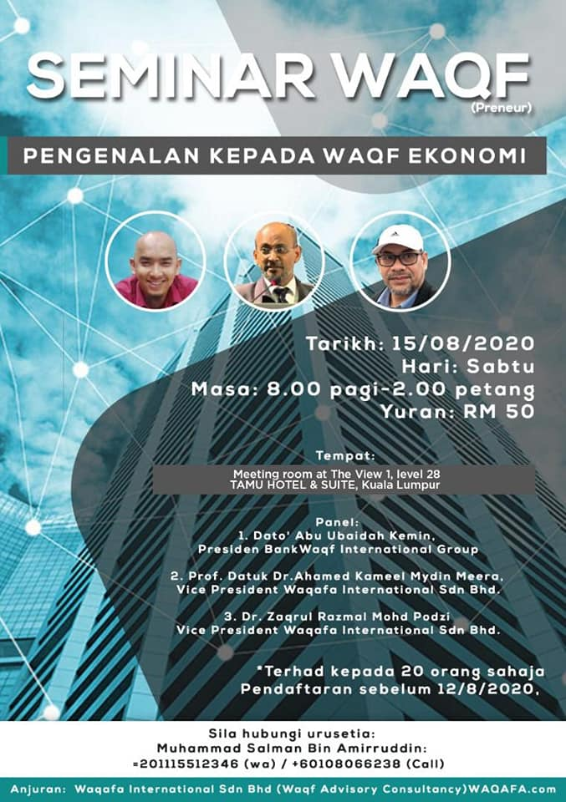
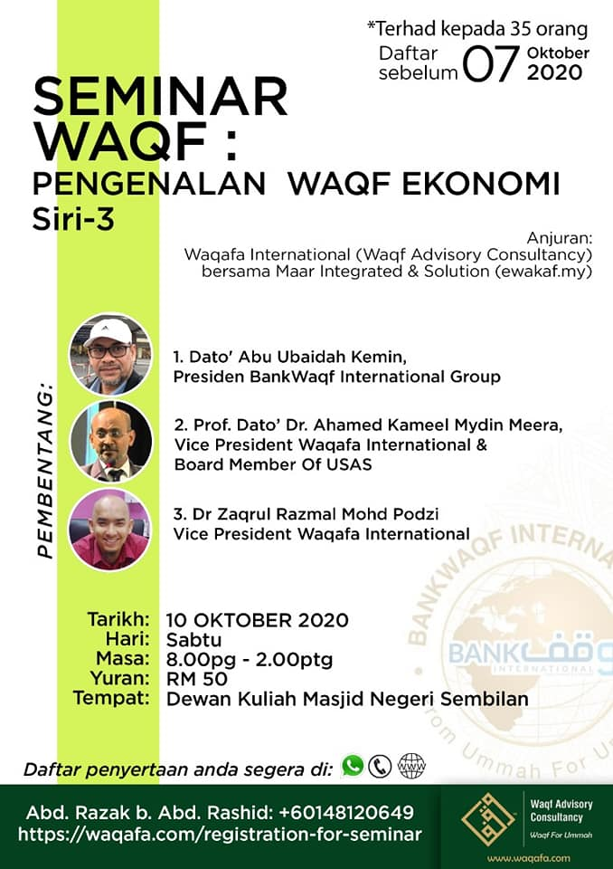
AWARENESS: SEMINAR & WEBINAR

Slide 35
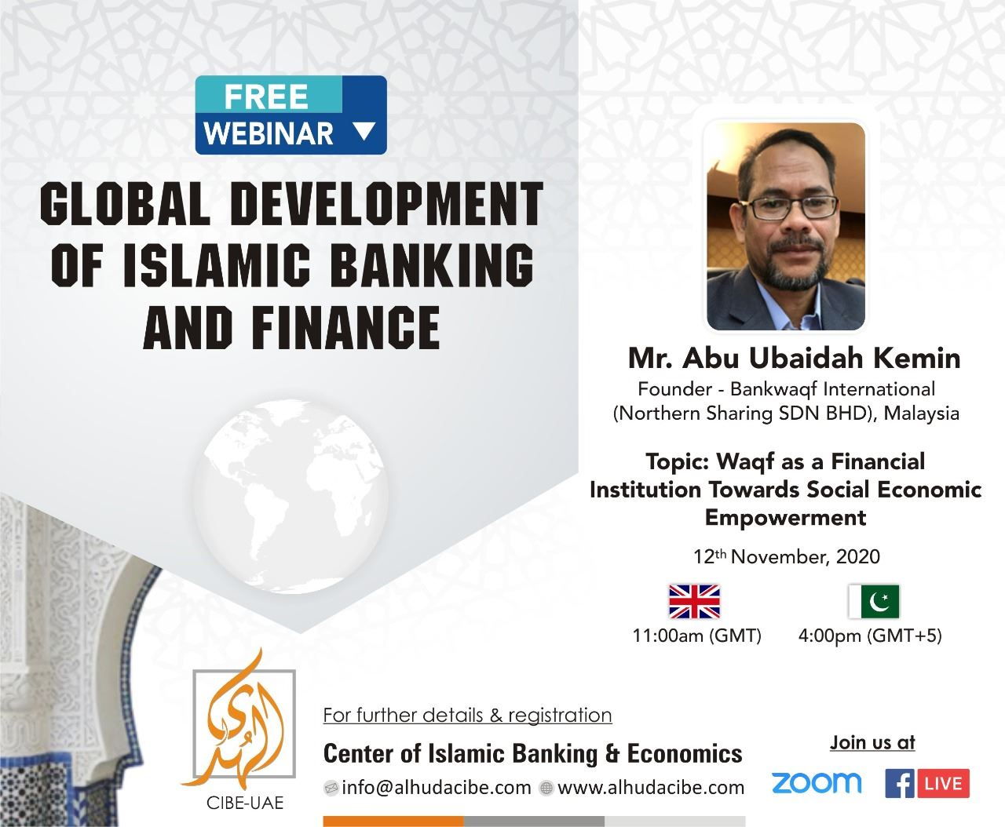
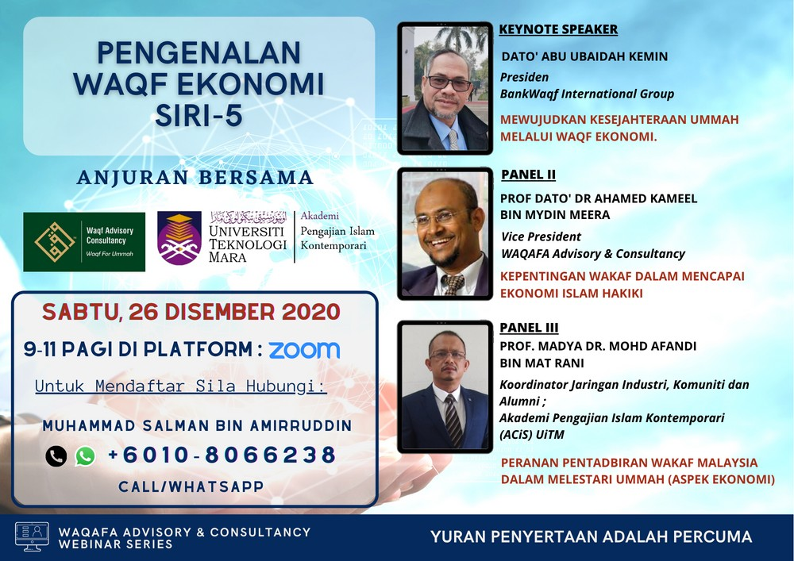
CONFERENCE

Slide 36
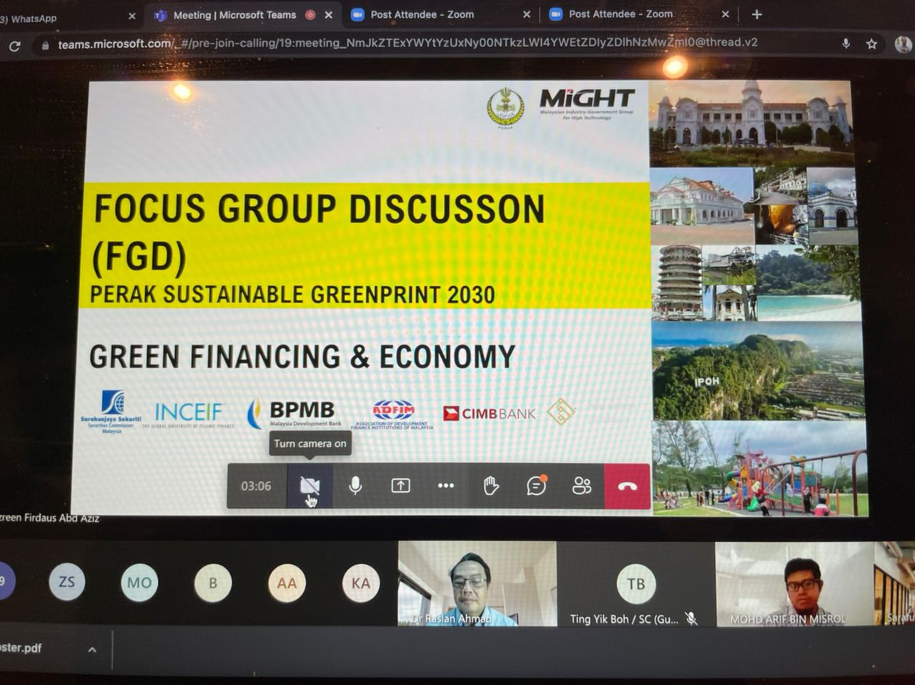
5
Advisory
ROUND TABLE DISCUSSION: National Waqf Master Plan
FOCUS GROUP DISCUSSION: Perak Sustainable Economic - Greenprint 2030
WAQF ROUND TABLE DISCUSSION: UKM & AGRO BANK
WORKING GROUP DISCUSSION:
TheWaqf Wellness

Slide 37
Our Partnership & Clients
6
Incoming Partnership

Slide 38
COMPANY INFORMATION
ADDRESS
11 - 04 Menara Arina Uniti Jalan Raja Muda Abdul Aziz Kampung Baru,
50300 Kuala Lumpur, Wilayah Persekutuan Malaysia
EMAIL
info@ waqafa. com
WEB
http://www. waqafa. com/

